Slide 1

Places in town / prepositions
Mesta u gradu / predlozi za mesto

Slide 2
A quick recap
Dear student,
Before we start the new lesson, let’s revise what we did last week…
Answer the following questions:
Pre nego što počnemo novu lekciju, ponovićemo šta smo radili prošle nedelje…
Odgovori na sledeća pitanja:

Slide 3
A quick recap
What’s an English word for…? (Write your answers in the notebook)
… frižider?
… šporet?
… lavabo?
… posuđe?*
*Refrigerator, stove, sink, dishes

Slide 4
A quick recap
Are these sentences correct? Write them in your notebook.
Da li su ove rečenice tačne? Prepiši sve četiri rečenice u svesku, netačne napiši pravilno.
A: There are a desk in my bedroom.
B: There is a six forks on the table.
C: There are two sofas in the living room.
D: Is there a carpet in your kitchen? *
*A-no B-no C-yes D-yes

Slide 5
Places in town
Dear student,
Watch this video https://www.youtube.com/watch?v=EfD2k9beP-4 and prepare to study new words for this week! ☺

Slide 6
Places in town
Dear student, klikni na ovaj link https://quizlet.com/_8arlm7?x=1jqt&i=2s6zma i izuči (i nauči ☺) nove reči koje su pomenute u YouTube videu.
(Kad odeš na link, videćeš kartice s rečima. Na svaku treba da klikneš da ti se otvori prevod. Ako skroluješ mišom na dole, videćeš te iste kartice, ali sa opcijom slušanja reči . Sa leve strane ekrana videćeš razne opcije učenja reči – learn, write, spell, test, games – prođi kroz sve vrste vežbanja, igrice su jako zanimljive! ☺ )

Slide 7
Places in town
What do you see? Look at the next slide and write a couple of sentences in your notebook. Every sentence should start with “there is…” or “there are…”.
For example: There is a movie theatre.
Šta vidiš? Pogledaj sledeći slajd I u svesci napiši nekoliko rečenica o slici. Svaka rečenica treba da počne sa “there is…” ili “there are…”

Slide 8
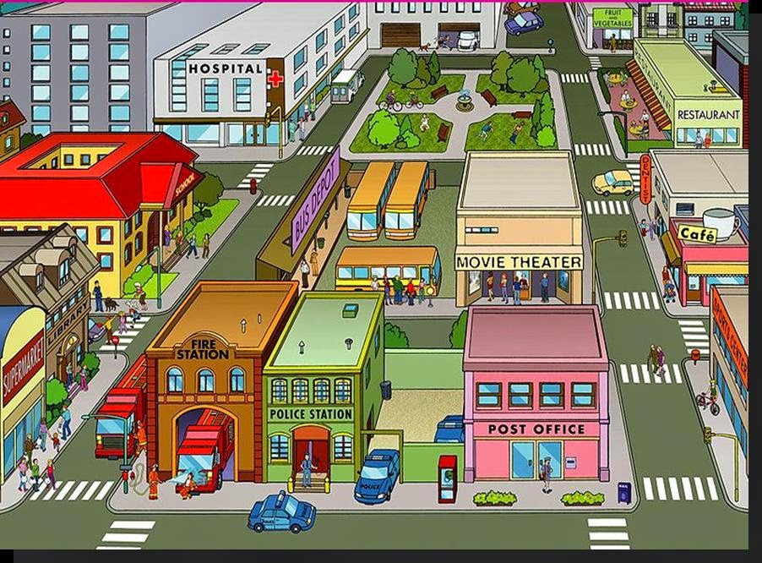

Slide 9
Prepositions
There are 7 prepositions for you to study and learn this week:
IN – u
NEXT TO – pored
BEHIND – iza
ON – na
OPPOSITE – preko puta
IN FRONT OF – ispred
BETWEEN – između

Slide 10
Prepositions
Look at slide 8 again and answer these questions in your notebook:
Example: Where is the police station? It’s next to the fire station.
Where is the fire station?
Where is the movie theatre?
Where is the school?
Where is the café?
Where is the supermarket?

Slide 11
Homework

Slide 12
Homework
Podsećam da ove nedelje NE ŠALJETE domaći na mejl.
Happy Easter holidays!! ☺

